Slide 1
Unit 5 – Module 2
Notes:
Lecture slides prepared by Dr Lawrie Brown (UNSW@ADFA) for “Data and Computer Communications”, 8/e, by William Stallings, Chapter 23 “Internet Applications - Internet Directory Service and the World Wide Web”.

Slide 2
DNS
The Internet Directory Service
the Domain Name Service (DNS) provides mapping between host name & IP address
defined in RFCs 1034 / 1035
key elements
  domain name space
  DNS database
  name servers
  name resolvers
Notes:
The Domain Name System (DNS) is a directory lookup service that provides a mapping between the name of a host on the Internet and its numerical address. DNS is essential to the functioning of the Internet. It is defined in RFCs 1034 and 1035. Four elements comprise the DNS:
• Domain name space: DNS uses a tree-structured name space to identify resources on the Internet.
• DNS database: Conceptually, each node and leaf in the name space tree structure names a set of information (e.g., IP address, type of resource) that is contained in a resource record (RR). The collection of all RRs is organized into a distributed database.
• Name servers: These are server programs that hold information about a portion of the domain name tree structure and the associated RRs.
• Resolvers: These are programs that extract information from name servers in response to client requests. A typical client request is for an IP address corresponding to a given domain name.

Slide 3
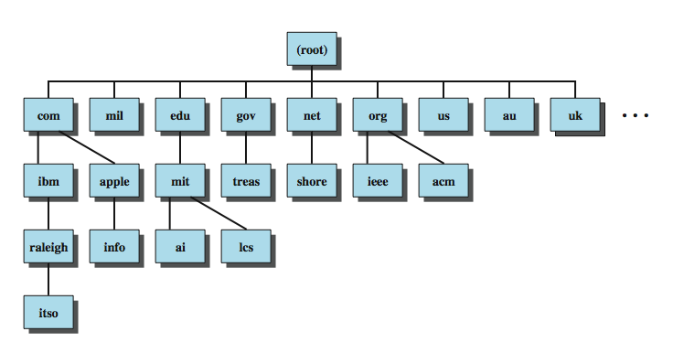
Domain Names
Notes:
The 32-bit IP address provides a way of uniquely identifying devices attached to the Internet. This address is interpreted as having two components: a network number, which identifies a network on the Internet, and a host address, which identifies a unique host on that network. A domain refers to a group of hosts that are under the administrative control of a single entity, such as a company or government agency. Domains are organized hierarchically, so that a given domain may consist of a number of subordinate domains. Names are assigned to domains and reflect this hierarchical organization. Stallings DCC8e Figure 23.1 shows a portion of the domain naming tree. At the very top level are a small number of domains that encompass the entire Internet. Each subordinate level is named by prefixing a subordinate name to the name at the next highest level. As you move down the naming tree, you eventually get to leaf nodes that identify specific hosts on the Internet. These hosts are assigned Internet addresses. An Internet-wide organization is responsible for assigning domain names so that every domain name is unique. The actual assignment of addresses is delegated down the hierarchy. For example, the main host at MIT, with a domain name of mit.edu, has four IP addresses: 18.7.21.77, 18.7.21.69, 18.7.21.70, and 18.7.21.110. The subordinate domain lcs.mit.edu has the IP address 18.26.0.36

Slide 4
DNS Database
hierarchical database
containing resource records (RRs)
features
  variable-depth hierarchy for names
  distributed database
  distribution controlled by database
provides name-to-address directory service for network applications
Notes:
DNS is based on a hierarchical database containing resource records (RRs) that include the name, IP address, and other information about hosts. The key features of the database are:
• Variable-depth hierarchy for names: DNS allows essentially unlimited levels and uses the period (.) as the level delimiter in printed names, as described earlier.
• Distributed database: The database resides in DNS servers scattered throughout the Internet and private intranets.
• Distribution controlled by the database: The DNS database is divided into thousands of separately managed zones, which are managed by separate administrators. The database software controls distribution and update of records.
Using this database, DNS servers provide a name-to-address directory service for network applications that need to locate specific servers. For example, every time an e-mail message is sent or a Web page is accessed, there must be a DNS name lookup to determine the IP address of the e-mail server or Web server.

Slide 5
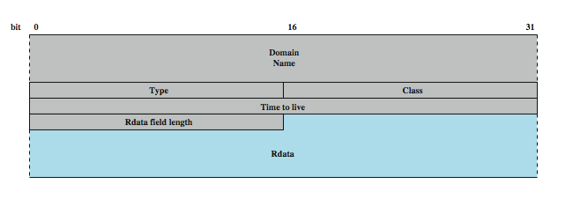
Resource Records (RRs)
Notes:
Stallings DCC8e Figure 23.2 shows the structure of a RR. It consists of the following elements:
• Domain name: Although the syntax of domain names in messages, described subsequently, is precisely defined, the form of the domain name in a RR is described in general terms. In essence, the domain name in a RR must correspond to the human readable form, which consists of a series of labels of alphanumeric characters or hyphens, separated by a period.
• Type: Identifies the type of resource in this RR. The various types are listed in Stallings DCC8e Table 23.2.
• Class: Identifies the protocol family. The only commonly used value is IN, for the Internet.
• Time to live: Typically, when a RR is retrieved from a name server, the retriever will cache the RR so that it need not query the name server repeatedly. This field specifies the time interval that the resource record may be cached before the source of the information should again be consulted. A zero value is interpreted to mean that the RR can only be used for the transaction in progress, and should not be cached.
• Rdata field length: Length of the Rdata field in octets.
• Rdata: A variable length string of octets that describes the resource. The format of this information varies according to the type of the RR. For example, for the A type, the Rdata is a 32-bit IP address, and for the CNAME type, the Rdata is a domain name.

Slide 6
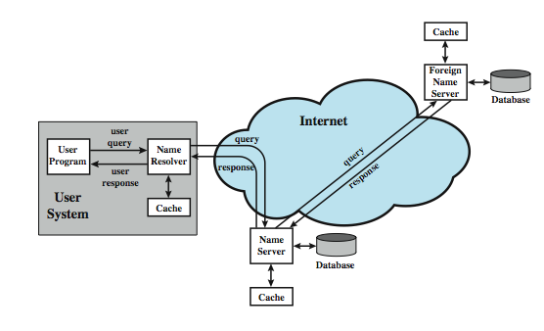
DNS Operation
Notes:
DNS operation typically includes the following steps, as shown in Stallings DCC8e Figure 23.3:
1. A user program requests an IP address for a domain name.
2. A resolver module in the local host or local ISP formulates a query for a local name server in the same domain as the resolver.
3. The local name server checks to see if the name is in its local database or cache, and, if so, returns the IP address to the requestor. Otherwise, the name server queries other available name servers, starting down from the root of the DNS tree or as high up the tree as possible.
4. When a response is received at the local name server, it stores the name/address mapping in its local cache and may maintain this entry for the amount of time specified in the time to live field of the retrieved RR.
5. The user program is given the IP address or an error message.
Typically, single queries are carried over UDP. Queries for a group of names are carried over TCP. The distributed DNS database that supports the DNS functionality must be updated frequently because of the rapid and continued growth of the Internet. Accordingly, dynamic updating functions for DNS have been defined. In essence, DNS name servers automatically send out updates to other relevant name servers as conditions warrant.

Slide 7
DNS Server Hierarchy
DNS database is distributed hierarchically
  may extend as deep as needed
any organization owning a domain can run name servers
each server manages authoritative name data for a zone
13 root name servers at top of hierarchy share responsibility for top level zones
Notes:
The DNS database is distributed hierarchically, residing in DNS name servers scattered throughout the Internet. Name servers can be operated by any organization that owns a domain; that is, any organization that has responsibility for a subtree of the hierarchical domain name space. Each name server is configured with a subset of the domain name space, known as a zone, which is a collection of one or more (or all) subdomains within a domain, along with the associated RRs. This set of data is called authoritative, because this name server is responsible for maintaining an accurate set or RRs for this portion of the domain name hierarchy. The hierarchical structure can extend to any depth. Thus, a portion of the name space assigned to an authoritative name server can be delegated to a subordinate name server in a way that corresponds to the structure of the domain name tree. For example, a name server corresponds to the domain ibm.com. A portion of that domain is defined by the name watson.ibm.com, which corresponds to the node watson.ibm.com and all of the branches and leaf nodes underneath the node watson.ibm.com.
At the top of the server hierarchy are 13 root name servers that share responsibility for the top level zones (Table 23.3). This replication is to prevent the root server from becoming a bottleneck. Even so, each individual root server is quite busy. For example, the Internet Software Consortium reports that its server (F) answers almost 300 million DNS requests daily (www.isc.org/services/public/F-root-server.html).

Slide 8
Name Resolution
query begins with name resolver on host
knows name/address of local DNS server
given a name request, the resolver can:
  return name from cache if already known
  send DNS query to local server which may return answer, or query other servers
recursive technique - server queries other servers for resolver
iterative technique - resolver queries servers in turn as needed
Notes:
As Stallings DCC8e Figure 23.3 (previous slide) shows, each query begins at a name resolver located in the user host system (e.g., gethostbyname in UNIX). Each resolver is configured to know the name and address of a local DNS name server. If the resolver does not have the requested name in its cache, it sends a DNS query to the local DNS server, which either returns an address immediately, or does so after querying one or more other servers. Again, resolvers use UDP for single queries and TCP for group queries. There are two methods by which queries are forwarded and results returned. Suppose a name server (A) forwards a DNS request to another name server (B). If B has the name/address in its local cache or local database, it can return the IP address to A. If not, then B can do either of the following:
1. Query another name server for the desired result and then send the result back to A. This is known as a recursive technique.
2. Return to A the address of the next server (C) to whom the request should be sent. A then sends out a new DNS request to C. This is known as the iterative technique.
In exchanges between name servers, either the iterative or recursive technique may be used. For requests sent by a name resolver, the recursive technique is used.

Slide 9
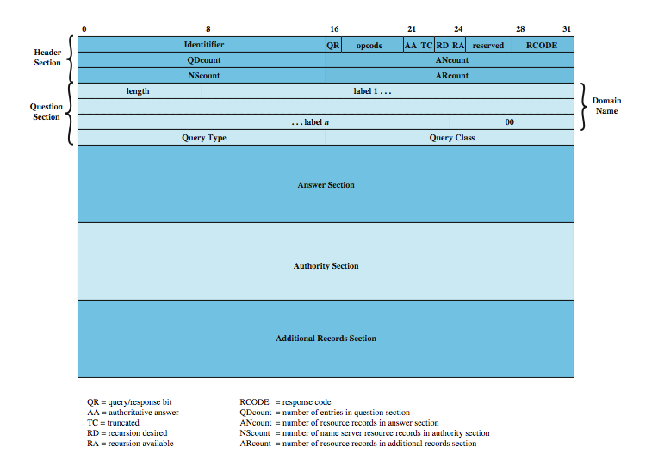
DNS Messages
Notes:
DNS messages use a single format, shown in Stallings DCC8e Figure 23.5. There are five possible sections to a DNS message: header, question, answer, authority, and additional records. The header section consists of:
• Identifier: Assigned by sender so can match queries and responses.
• Query Response: Indicates whether this message is a query or response.
• Opcode: standard query, an inverse query, or a server status request.
• Authoritative Answer: if responding name server is an authority
• Truncated: if response message was truncated due to length
• Recursion Desired: If set, directs the server to pursue the query recursively.
• Recursion Available: if recursive query support is available
• Response Code: no error, format error, server failure, name error, not implemented, or refused
• Qdcount, Ancount, Nscount, ARcount: no RRs in the question/ answer/ authority/ additional records section (zero or more).
The question section contains the (usually one) query for the name server, with the Domain Name, Query Type, and Query Class.
The answer section contains RRs that answer the question; the authority section contains RRs that point toward an authoritative name server; the additional records section contains RRs that relate to the query but are not strictly answers for the question.

